Slide 1


Team:
Alexandru Grigoras, NYU Shanghai, China. (ag4601@nyu.edu).
Sara Alarifi, Al Faisal University, KSA. (salarifi@alfaisal.edu)
Khalid AlAwar, Khalifa University, UAE. (Kaloodi196@gmail.com)
Randa Abuali, University of Sharjah, UAE. (randa.abuali1@gmail.com).
Ahmed Abdulhamid, Khalifa University, UAE. (Afrotoo1519@gmail.com)
Mentors:
Razan Qraini, Software Engineer, Experts Turnkey Solutions, Palestine. (r.qraini@gmail.com).
Stephen Lang, UI/UX Designer, Cornell Tech, USA. (steplang@gmail.com)

Slide 2
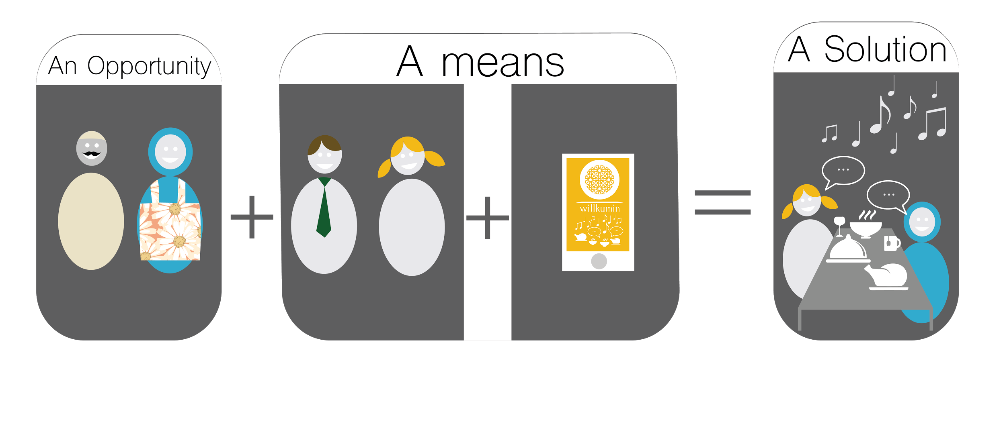
Paradigm

Slide 3


Slide 4
Demo time

Slide 5


Slide 6
